Slide 1
Working memory in children with mathematical disabilities
Frauke De Weerdt
Annemie Desoete
Herbert Roeyers
Experimental-Clinical and Health Psychology
Faculty of Psychology and Educational Sciences
Ghent University

Slide 2
Overview
THEORETICAL BACKGROUND
Mathematical disabilities (MD)
Working memory
Working memory and MD
Reading and spelling in MD
2. METHOD
Research questions
Instruments
Procedure
RESULTS
4. DISCUSSION & CONCLUSION

Slide 3
1. THEORETICAL BACKGROUND Mathematical disabilities (MD)
Definition MD:
Impairment in mathematical abilities
Exclusion, Below Expected and RTI criteria
Prevalence: 3 - 14% (Barbaresi, Katuskic, Colligan, Weaver, & Jacobsen, 2005; Desoete, 2007; Dowker, 2005)

Slide 4
Defining features:
Arithmetic facts
Mathematical procedures

Slide 5
Etiology:
High heterogeneity:
Defective number module (Butterworth, 2005)
Impaired number sense and mental number line (Dehaene, Piazza, Pinel & Cohen, 2003)
Working memory (Bull & Scerif, 1999)

Slide 6
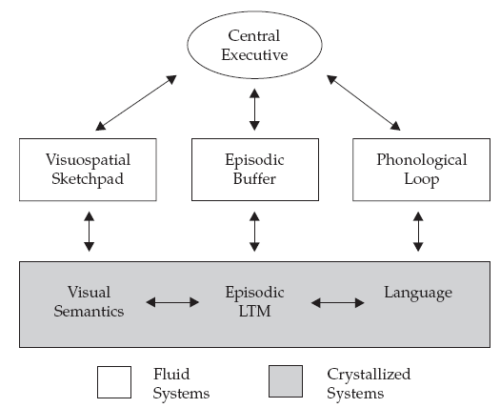
1. THEORETICAL BACKGROUND Working memory (WM)
WM model of Baddeley (1974; 2000)
Most common (Landerl, Bevan, &
Butterworth, 2004 )
Components:
Central Executive
Phonological Loop
Visuospatial Sketchpad
Episodic Buffer Figure 1: Current model of WM (Baddeley, 2002, p .93)

Slide 7
1. THEORETICAL BACKGROUND Working Memory and Mathematical Disabilities
WM and fact retrieval
(Desmedt et al., 2009; Lee & Kang, 2002; Noel, Seron, & Trovarelli, 2004)
WM and procedural knowledge (Wilson & Dehaene, 2007)
Slave systems: ambiguous results (D’Amico & Guarnera, 2005; Gathercole & Pickering, 2000)

Slide 8
1. THEORETICAL BACKGROUND: Reading, spelling, MD and WM
High comorbidity with RD (Lyytinen et al., 2005; Shalev, 2000, 2004)
Reading and spelling associated with WM (St Clair-Thompson & Gathercole, 2006)
BUT: Lack of MD studies taking reading and spelling into account

Slide 9
2. METHOD
Research questions
Does WM have an influence on fact retrieval and procedural knowledge (Desmedt et al., 2009)?
Do children with MD have sig. lower scores on WM tasks than average achieving children, even when controlling for reading and spelling (Passolunghi, 2004; Schuchardt et al., 2006)?

Slide 10
Participants
Recruitment in schools and RC’s
FSIQ ≥ 80
Normal range DBD (Pelham, Gnagy,
Greenslade & Milich, 1992; Dutch translation:
Oosterlaan et al., 2008)
MD group: exclusion-, below expected -, RTI- criteria

Slide 11
Participants
 | MD (N=36) | AA (N=55)
Age in months | 120.83 (11.80) | 119.96 (11.02)
FSIQ | 95.42 (8.39) | 108.58 (9.85)
M:F | 6:30 | 25:30

Slide 12
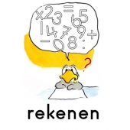
Children: Session 1 (80’)
Spelling test (20’)
PI-dictation (Geelhoed & Reitsma, 2000)
Math tests (60’)
TTR (de Vos, 1992)
Fact retrieval
Courtrai’s Arithmetic Test-Revised (Baudonck et al., 2006)
Procedural knowledge

Slide 13
Children: Session 2 (50’)
Intelligence test (40’)
Abbreviated WISC-III^{NL}
(Wechsler et al., 2002; Grégoire, 2000)
Reading tests (10’)
One Minute Test (Brus & Voeten, 1999)
Existing words
Klepel (van den Bos, Spelberg, Scheepstra & de Vries, 1994)
Pseudowords

Slide 14
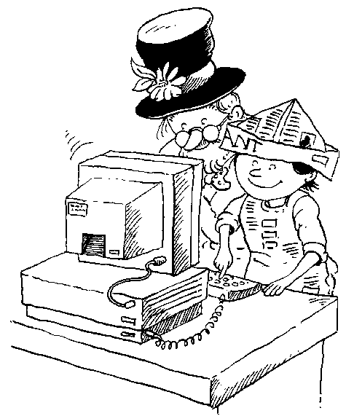
Session 3 (90’):
Working memory tasks

Slide 15
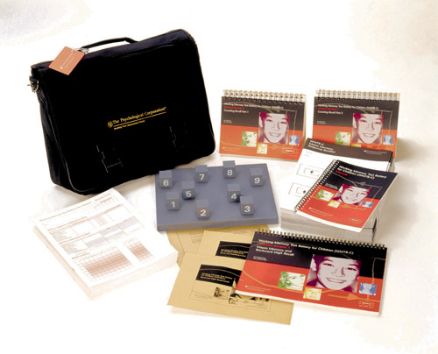
WMTB-C & AWMA
Span tasks
6 trials/span
≥ 3 errors/span: task discontinued

Slide 16
Phonological Loop : Digit Recall (DR)
500 ms
1000 ms/digit;
1000 ms between digits of same trial

Slide 17
Phonological Loop : Word Recall (WR)
500 ms
1000 ms/word;
1000 ms between words of same trial

Slide 18
Visuospatial Sketchpad: Block Recall (BR)
500 ms
1000 ms/block;
1000 ms between blocks of same trial

Slide 19
Central Executive: Listening Recall (LR)
500 ms
2000 ms

Slide 20
Central Executive: Spatial Span (Spsp)
500 ms
unlimited
500 ms
De Weerdt et al. – Working memory in children with mathematical disabilities
Rekengroep - 25/01/2011

Slide 21
Central Executive : Backward Digit Recall (BDR)
500 ms
1000 ms/digit;
1000 ms between digits of same trial

Slide 22
Central Executive : Backward Word Recall (BWR)
500 ms
1000 ms/word;
1000 ms between words of same trial

Slide 23
Central Executive: Backward Block Recall (BRB)
500 ms
1000 ms/block;
1000 ms between blocks of same trial

Slide 24
3. RESULTS
WM, procedural knowledge and fact retrieval
Procedural knowledge
Sig. influence of PL, VSSP and CE
PL: F(1,89)= 6.99, p ≤. 01, adj. R²=.06
VSPP: F(1,89)= 5.35, p ≤ .05, adj. R²=.05
CE: F(1,65)= 20.33, p ≤. 001, adj. R²=.23

Slide 25
WM, procedural knowledge and fact retrieval
Fact retrieval
Sig. influence of PL, VSSP and CE
PL: F(1,89)= 5.46, p ≤. 05, adj. R²=.05
VSPP: F(1,89)= 11.61, p ≤ .001, adj. R²=.11
CE: F(1,65)= 14.81, p ≤. 001, adj. R²=.17

Slide 26
Working memory in children with MD
Mancova: computed z-variables acc PL, VSSP, CE
Main effect group, no main effect gender, no interaction
η²= .08
*
η² = .14
**
η² = .08
*

Slide 27
Working memory in children with MD
Ancova’s: raw scores accuracy PL, VSSP and CE
η² = .06
*
η² = .06
*
η² = .08
*
η² = .06
*
η² = .16
**

Slide 28
Working memory in children with MD
Mancova: mean RT PL, VSSP, CE
No main effects, sig interaction-effect group*gender
η² = .08
*

Slide 29
Working memory in children with MD
Ancova’s: task RT PL, VSSP and CE
η² = .05
*
η² = .07
*

Slide 30
Reading and spelling in children with MD
Sig. difference in reading and spelling performance between AA and MD group
Reading: t (89)= 5.47, p < .00
Spelling: t (89)= 6.72, p < .00
High correlations between spelling/reading and math
Reading and fact retrieval: r=.58, p ≤ .01
Reading and procedural knowledge: r=.39, p ≤ .01
Spelling and fact retrieval: r=.56, p ≤ .01
Spelling and procedural knowledge: r=.43, p ≤ .01

Slide 31
Working memory in children with MD in control of reading
Mancova computed z-scores PL, VSSP and CE
Only main-effect of group
η² = .18
**
η² = .10
*

Slide 32
Working memory in children with MD in control of spelling
Mancova computed z-scores PL, VSSP and CE
Main-effect of group; and main-effect of covariate!
η² = .11
**
η² = .07
*
η²= .09
η²= .11
**

Slide 33
4. DISCUSSION AND CONCLUSIONS
Summary of results
Sig. lower acc DR, BR, DRB, BRB, SpSp
Role of CE!
Influence of spelling in WM in children with MD
Sig. large r math and reading/spelling
Children with MD suffer from WM problems
Impact of spelling on math performance

Slide 34
Implications
Spelling test
Reading tests?!
WMTB-C
Treatment = more than just math!
De Weerdt et al. – Working memory in children with mathematical disabilities
Rekengroep - 25/01/2011

